Slide 1
Vicki McGarvey
Learning and Information Services Manager
Collection Management,
Research & Digital Resources
@vickimcgarvey vicki.mcgarvey@staffs.ac.uk
eBooks, as another window opens…
another one closes…
then another one opens…
Notes:
Good afternoon everyone it is great to see so many people on the line. The topic of eBooks is obviously a popular subject. I am going to just give a preamble to Erica’s and Ben’s presentation to provide a bit of context.
I am a member of the UKSG Education Committee and through our surveys and events we have had requests and comments about the eBook issues together with questions about what support UKSG can provide in this area. I have also been contributor to this conversation as a collection manager hence my presence today.
My experience is very much like this picture with eBooks I sometimes feel that I cannot see the sky. I address one challenge I can see a bit of sunlight then another arises and this can often be contextual. For example at Staffordshire we are branding ourselves as a digitally connected University and have seen an increase in the use of ebooks but from a behavioural perspective dipping into sections rather than downloads, all good. However, we have considerable reduction in budget over the last 3 years and have opted for credit models of eBooks to enable concurrency but what happens when you run out of credits and money. So now we are thinking that using a combined 3 license 1 license back-up is more sustainable, better to be locked out 1 day than 6 months. Hopefully you can see what I mean by one window opening another closing then another opening.

Slide 2
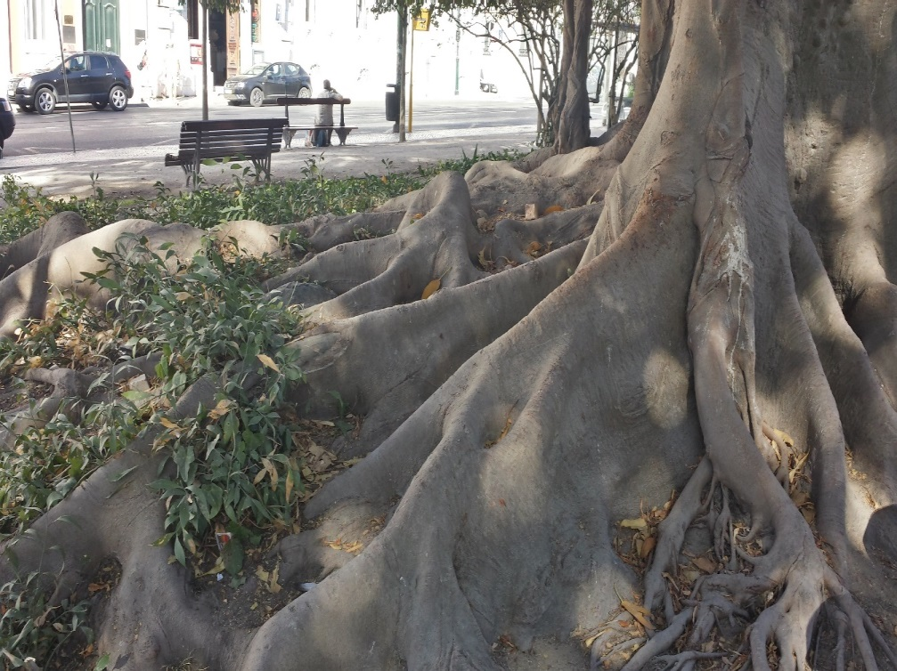
Identifying the roots of the issues…
Business Models
Promotion
Accessibility
Evaluation
New Trends
eText Books
“How can UKSG
make the eBook
horizon clearer
for YOU?”
Notes:
From questions we have received in advance, which by the way are excellent, we can see that there are vast array of challenges that we as a community need to address and share solutions for with respect eBook management. Some of your questions we may be able to answer today but some may require a longer extended discussion. We may all share the same root of an issue, which we know can be extremely complicated but how we address an issue may have contextual element, for example, finance, size of cohort and discovery. So your reflections today will be really useful to UKSG in our task to make the horizon clearer.

Slide 3
E-books Now: An introduction to managing e-books
Erica Lee
Information Resources Specialist
Aston University

Slide 4
Outline
Purchasing options
Suppliers
DRM
Print vs electronic
Purchasing models
Managing your collection
Display
Marc records
Usage stats

Slide 5
Purchasing options: Suppliers
Multiple suppliers and platforms?

Slide 6
Purchasing options: DRM
Restrictions on printing/copying and downloading
Differs by platform and publisher
Content on publisher platforms is often DRM free
Purchasing individual titles from publishers

Slide 7
Purchasing options: Print and e?

Slide 8
Purchasing options: Subscriptions
Zombies and Sexuality: essays on desire and the living dead
Large aggregator packages/
smaller subject collections
Content moves in and out
Useful for expanding the breadth of
your collections
Publisher subscriptions
Why Buffy matters: the art of Buffy the Vampire Slayer

Slide 9
Purchasing options: Outright purchases
Fixed packages
Sometimes annual platform fee
Individual titles purchased from either publishers or aggregators

Slide 10
Purchasing options: Outright purchase models
Single user – downloadable or not downloadable?
Multi-user 3 users? 5 users? 10 users? Unlimited users?
Credit model
“Expiring” models
Mixing models

Slide 11
PDA (Patron Driven Acquisition)

Slide 12
Reading list PDA

Slide 13
EBA (Evidence-based Acquisition)

Slide 14
Purchasing options: Rentals/Short term loans
Based on % of full price of title
Useful for ILL
Can be combined with PDA
Moore, A. 2014. Instant fulfilment: the successful use of patron driven acquisitions to satisfy interlibrary loans. In: Woodward, H. (ed.) Ebooks in Education: Realising the Vision. Pp. 79–90. London: Ubiquity Press. DOI: http://dx.doi.org/10.5334/bal.i

Slide 15
Purchasing options: Direct to Student
Each student given their own copy for period of time
Available via publishers and services such as VitalSource and Kortext
Can be expensive but great service for students

Slide 16
Managing your collection: Display

Slide 17
Managing your collection: Marc records
Loading e-book marc records into catalogue
Direct from publishers, aggregators or OCLC
Knowledge bases (journals A-Z list)

Slide 18
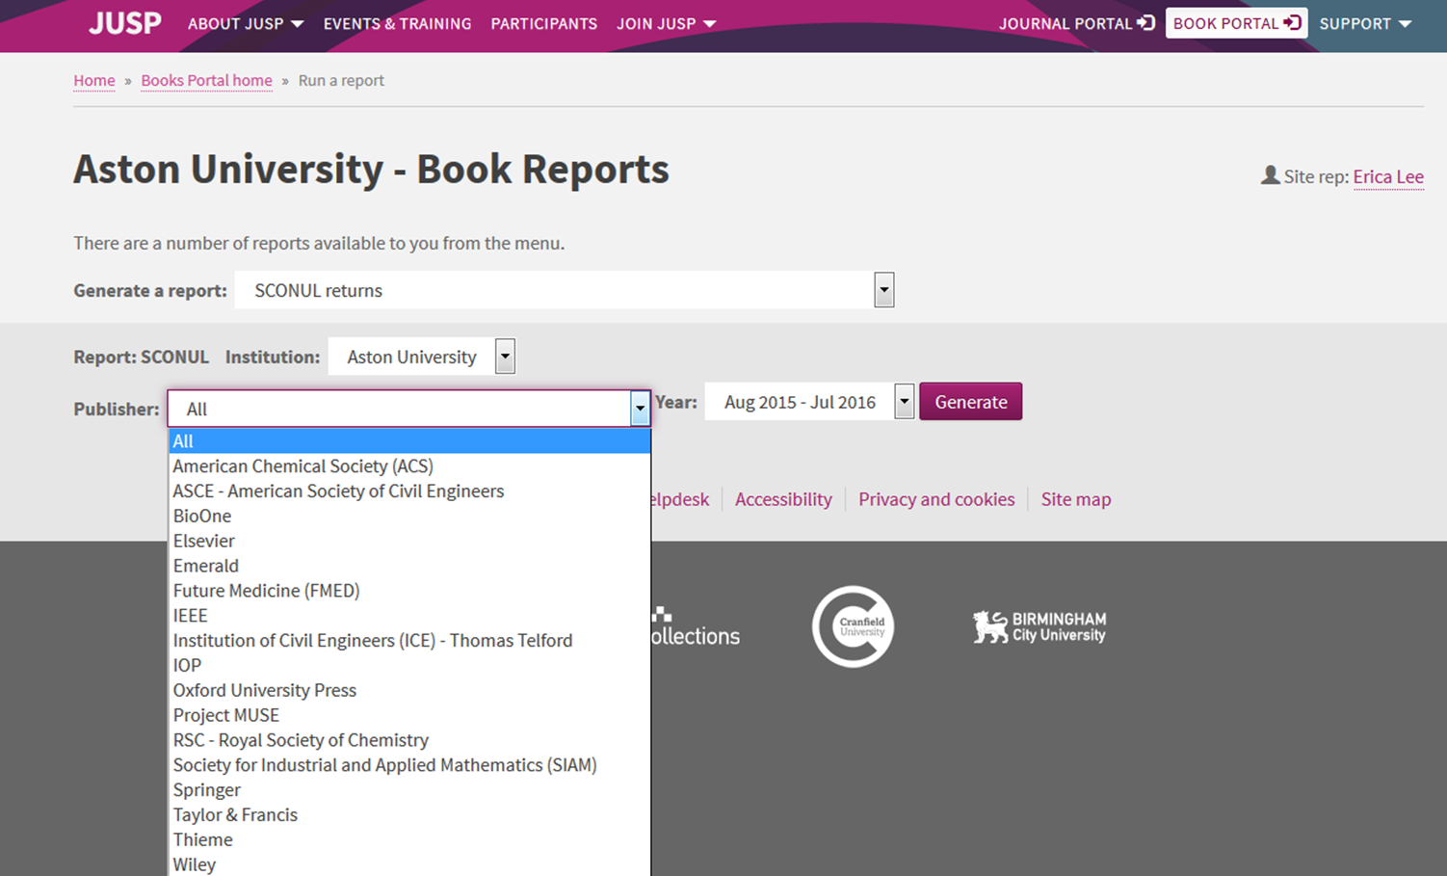
Managing your collection: Usage statistics
Turnaways
JUSP

Slide 19
The eBook accessibility audit
Ben Watson, University of Kent

Slide 20
Talk blurb
Background to the eBook accessibility audit
Story of disability and library professionals coming together to crowdsource a solution to a universal problem
Audit outputs as a way to measure basic accessibility functionality and guide platform improvement across the sector
The eBook accessibility audit introduces benchmark for accessibility in eBook platforms:
meaningful minimum standard for mainstream platforms.
‘translation' of technical standards into plain English that relate to reader's everyday experiences.
raise awareness of inherent accessibility potential of eBooks.

Slide 21
People i.
Jisc - Alistair McNaught is an accessibility and inclusion specialist with a long engagement in the Publishers Association Accessibility Action Group.
Leeds Beckett University - Sue Smith, Vicky Dobson and Jamie Phillips bring library expertise, direct experience with disabled students, project management skills and expertise in Excel spreadsheets.
Manchester Metropolitan University - Gopal Dutta is a library specialist with links to procurement projects.

Slide 22
People ii.
University of Kent - Ben Watson is from a library background but now manages an institution-wide accessibility project for the university.
University of Liverpool - Jane Cooke is Head of Content, Collections and Discovery at the University of Liverpool.
York St John University - Ruth MacMullen is a Copyright and Licences Officer with a special interest in disability issues. Ruth set up the LIS-Accessibility JiscMail list.

Slide 23
Why did we do it?
Notes:
The heart of our motivation is the dignity and independence of readers. It is not unusual for textbooks on an eBook platform to be unavailable to print impaired readers because the accessibility features they require are not supported. They have to request an alternative format, slowing down access and reducing independence. Even where platforms support accessibility, it is often difficult to find information on what is available.
Crowd sourcing an audit using library professionals who are not accessibility professionals presents its own challenges but is a good reflection of user experience. Many students with print impairments have a very narrow comfort zone with technologies and assistive technologies.
We provided a face-to-face training afternoon for some volunteers and created a detailed online guidance resource that was available for all participating testers. The key elements of the project included:
Crowd sourced ‘target list’ of aggregators so we were focusing on platforms that testers were using daily with students.
‘Plain English’ accessibility criteria - accessibility is often regarded as technical and therefore difficult. We focused on plain English descriptions of features the user might need and how to test them.
Liaison with Publishers Association Accessibility Action Group - this group gave valuable advice and guidance on how to develop and present the audit in a way that maximised publisher collaboration and minimised polarisation.
Supporting ‘How to’ resources were made available - to help the significant number of people (around 60%) who were conducting an order for the first time.
Crowd sourced volunteers - from 33 higher education institutions. Some institutions use this as a training opportunity for entire library departments. In total we had over 90 testers.
Standardised survey - the audit was completed through a standardised online survey form which fed the results into a spreadsheet.
Centrally collated spreadsheet - this was exported into Excel where additional functionality could be added.
Follow up survey - this gave us information on people's experience of doing the survey, the value they attached to the process as well as the outcomes and the impact it had on their understanding of disabled students and the need for accessible procurement.
Create interactive assessment tool - using expertise from Leeds Beckett University we turned the spreadsheet into an interactive assessment tool that allowed a nuanced evaluation of platforms by weighting different accessibility features.
Create supporting website with discussion area - this is now available at https://sites.google.com/site/ebookaudit2016/

Slide 24
Electronic books should be the answer
Notes:
Electronic resources are fundamentally more accessible than their print equivalents as they can be easily manipulated to support different learning styles.
Mainstream methods of delivery (e.g. standard commercial eBook platform)?
No guarantees that the eBook platforms deliver a consistent standard of accessibility.
Good for everyone – part-timers, commuters

Slide 25
Where does the problem lie?
Notes:
This flow diagram shows how different publishers with different accessibility investments supply their materials into a range of aggregator services that deliver to higher education institutions. In the process, accessibility investments in the source file may be undermined by the aggregator. For example Onix accessibility data (codelist 196) may be provided by the publisher but not ingested by the aggregator. Or the source file may be capable of a wide range of magnification with full reflow but the interface used by the aggregator supports neither.
Once an institution different accessibility experiences can result depending on the platform used, the file format selected, the tool used for delivery (browser version, browser age, browser type, or versions of Adobe reader/Adobe Digital editions). This in turn may create interoperability problems for screen readers or text-to-speech tools et cetera. The users needs may therefore remain unmet, despite the publisher having done everything in their power to meet them.
Needless to say, a disgruntled student is most likely to blame the publisher whose name is highlighted on screen rather than the players in between.

Slide 26
eBook accessibility ‘attrition’
Notes:
Visualising the different areas of the supply train where accessibility features can be lost. We felt it was important for suppliers to do their own audit as a triangulation to help them contextualise these risks.

Slide 27
Motivation
It’s the right thing to do…
Disabled Students Allowance (DSA) imperative
Don’t we pay for this anyway?
If an electronically accessible resource cannot be found, a catalogue of interventions is required to deliver an alternative format.
Obtaining materials in alternative formats is costly and time-consuming - estimated £0.96 per page!
Notes:
A breakdown of the costs of obtaining resource in alternative formats has been published by Andy McMahon at the University of Dundee e.g. cost for manual scanning = £0.96 per page.
McMahon (2016) Alternate Formats Annual Report 2015/16. [Online]. Available at: http://atanet.org.uk/wp-content/uploads/2016/07/University-of-Dundee-Alternate-Formats-Annual-Report.pdf (Accessed: 20/08/2016).
Good news - nobody has been sued (in the UK).
Bad news – it would be easy to make the case on the basis of.
Neglect of anticipatory duty (HESA - Higher Education Statistical Analysis service - statistics for disabled students show an average of over 10% disabled students in HE. In some arts based institutions it is 20 – 30%. Demographic trends show 1in 10 having dyslexia, HESA trends show increasing % of disabled students applying to HE every year. Changes to the disabled student allowance (DSA) require organisations to remove accessibility barriers at source.
This requires
Information in accessible formats
Reading lists that take account of ease with which accessible formats can be obtained
Avoiding poor procurement choices where organisations pay for systems with low accessibility.
Lack of reasonable adjustment is another reason you can be sued. Reasonable adjustments in terms of accessible information may take various forms like:
Direct supply from publisher
In-house scanning
Third party service – e.g. RNIB Bookshare

Slide 28
Alternative formats: the catalogue of interventions?
Notes:
For some students printed material is not suitable, because it cant be easily be: reformatted for easier reading, read aloud by screen readers.
Accessible eBooks and e-journals overcome access barriers.
If an electronically accessible resource cannot be found, a catalogue of interventions is required to deliver an alternative format.

Slide 29
Process
The LIS-Accessibility mailing list.
Pre-survey questionnaire to identify most frequently used platforms.
Sign up to audit platforms - crowd-sourced data.
eBook Accessibility Audit Form.
user experience study easily checked by non-specialists (such as text display, navigation, text to speech, image description, accessibility guidance).
Clear guidance for doing the audit and understanding the data.
Crunch the data.
Publish the findings.
Notes:
The involvement of the supplier was critical because they may have little control over the delivery environment. Publishers assessing their own products gave them a vested interest in the process as well as the opportunity to identify differences between the inherent accessibility provided and the delivered accessibility experienced by the reader. It is impossible to resolve the weak links in the supply system (some of which may exist in the HEI themselves – for example out of date browsers) without identifying first where they occur.
eBook Accessibility Audit Form
user experience study that could be checked easily by non-specialists (such as text display, navigation, text to speech, image description, accessibility guidance).
The LIS-Accessibility mailing list
Amassing helpers.
The audit – a feast of uncertainties
Crowd sourcing an audit using library professionals who are not accessibility professionals presents its own challenges but is a good reflection of user experience. Many students with print impairments have a very narrow comfort zone with technologies and assistive technologies.
We provided a face-to-face training afternoon for some volunteers and created a detailed online guidance resource that was available for all participating testers. The key elements of the project included:
Crowd sourced ‘target list’ of aggregators so we were focusing on platforms that testers were using daily with students.
‘Plain English’ accessibility criteria - accessibility is often regarded as technical and therefore difficult. We focused on plain English descriptions of features the user might need and how to test them.
Liaison with Publishers Association Accessibility Action Group - this group gave valuable advice and guidance on how to develop and present the audit in a way that maximised publisher collaboration and minimised polarisation.
Supporting ‘How to’ resources were made available - to help the significant number of people (around 60%) who were conducting an order for the first time.
Crowd sourced volunteers - from 33 higher education institutions. Some institutions use this as a training opportunity for entire library departments. In total we had over 90 testers.
Standardised survey - the audit was completed through a standardised online survey form which fed the results into a spreadsheet.
Centrally collated spreadsheet - this was exported into Excel where additional functionality could be added.
Follow up survey - this gave us information on people's experience of doing the survey, the value they attached to the process as well as the outcomes and the impact it had on their understanding of disabled students and the need for accessible procurement.
Create interactive assessment tool - using expertise from Leeds Beckett University we turned the spreadsheet into an interactive assessment tool that allowed a nuanced evaluation of platforms by weighting different accessibility features.
Create supporting website with discussion area - this is now available at https://sites.google.com/site/ebookaudit2016/

Slide 30
Publisher involvement
Universities and suppliers have the same goal - more students reading more books more independently.
Publishers Association Accessibility Action Group invited to contribute at all stages:
ensure balanced, non-partisan advice
Sage invited to every key meeting to represent publishers:
“exciting opportunity to highlight the significant accessibility investments the industry has made over recent years. Considerable strides have been made to improve and support accessibility throughout the sector and this valuable initiative will allow us to continue to learn and develop together.”

Slide 31
Testing
The testing was done by 33 universities and 5 suppliers (suppliers were invited to audit their own platforms).
In total 44 platforms were tested, covering 65 publishers with nearly 280 eBooks tested.

Slide 32
The benefits:
Academics can prioritise accessible publishers and platforms.
Suppliers - focus on strengths and improving weaknesses.
'audit trail' to identify 'accessibility attrition' in supply chain
Libraries, publishers, aggregators have common language for constructive conversations.
Increased awareness of eBook accessibility benefits for library and disability support staff.
Resource by which readers can identify eBook platforms which most closely meet their specific needs.
Notes:
From an institutional perspective, improved accessibility results in fewer alternative format requests and lower support costs.
1) a tool that would allow accessible platforms to be more visible
2) a narrative that would explain and explore accessibility in its wider context
3) an 'audit trail' that would begin to identify 'accessibility attrition' in different parts of the supply chain so that appropriate dialogues can take place.

Slide 33
A common language with publishers
Notes:
Askews and Holts have used the audit to clarify accessibility guidance for customers.
The image shows the mirroring of eBook accessibility audit questions on their accessibility statement.

Slide 34
Individual platform feedback reports
Notes:
Individual Platform Feedback Reports section of the website. The table on page 6 of the reports may be particularly useful for Library staff - it gives an at-a-glance view of how well the platform met each of the criteria. We will now be encouraging platforms to look at their own report and hopefully use it to inform developments.

Slide 35
Individual platform feedback reports example

Slide 36
Key elements of eBook accessibility
Notes:
We also added information on the Key elements of eBook accessibility which describes the criteria used to audit the eBooks along with an explanation of why each of them is important for accessibility.

Slide 37
The future
Regional purchasing consortia using the accessibility data as part of procurement process:
market advantages to accessibility.
making it cost-effective for suppliers to make the necessary investments.
Critical mass of awareness university context:
33 out of 130 UK universities took part
follow-up survey staff showed significant increase in accessibility awareness, changed skill levels, confidence, and empathy with disabled learners
Widespread agreement that eBook accessibility should influence library procurement.
Over 90% first time testers felt 'better equipped to advise disabled readers’.

Slide 38
Michael Moore: Librarians ‘the most dangerous people in society’
On dispute with Harper-Collins (HC) about Stupid White Men
Told to ‘tone down’ criticism of Bush – or HC would dispose of 50,000 copies.
Moore mentioned grievance to a union group.
A librarian happened to be in the audience.
She wrote to the other librarians via listserv [an early Web discussion group] about HC not publishing book.

Slide 39
!
A few days later:
Editor at Harper-Collins: [screaming]: What did you tell the librarians?
Michael Moore: I didn't tell the librarians anything!
Editor at Harper-Collins: [screaming]: Well they're out there picketing us. In Manhattan!
Notes:
http://www.upi.com/Michael-Moore-honors-librarians-at-Notable-Books-event/20661367177507/

Slide 40
Effect change
Michael Moore:
The most important thing it did was to remind me that [people] can effect change. We should have a Rosa Parks holiday to tell people, don't just sit there, do something. We need to dispel the great lie that you can't do anything about things.
End result = book published ☺
Notes:
Moore is organizing a group of fellow authors advocating critical library issues such as better pay, better benefits, sexism and pay equity. Through his website he is offering videos of his television shows as well as his previous movies free to all librarians. He is also offering an endowment to establish a scholarship for minorities who wish to become librarians. He considers librarians "the most important public servant in a democracy."

Slide 41
Links and contact
The site
eBook accessibility audit (UK Higher Education)
Contact us
ebookaudithelp@gmail.com

Slide 42
Thank you. Any questions?
Vicki McGarvey - vicki.mcgarvey@staffs.ac.uk
Erica Lee - e.j.lee@aston.ac.uk
Ben Watson - B.Watson@kent.ac.uk

